Slide 1

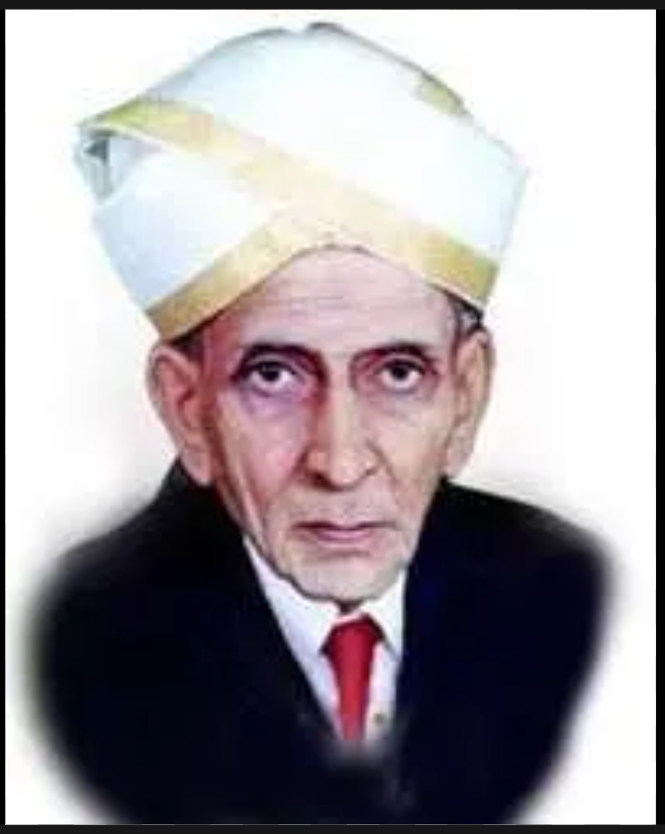


Happy Engineers’ Day
AMBEKESHWAR GROUP
OF INSTITUTIONS
Technology & Managament
Lucknow
Suraj Arya,
CSE 2nd Year

Slide 2

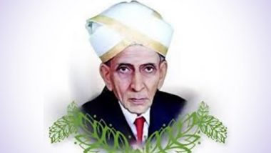

Why are we celebrating engineers day ?
In the memory of
Sir Mokshagundam Visvesvaraya
BIRTH : 15 September 1861
DIED : 12 April 1962
AWARDS : BHARAT RATANA
Education : College of engineering, pune University of madras

Slide 3


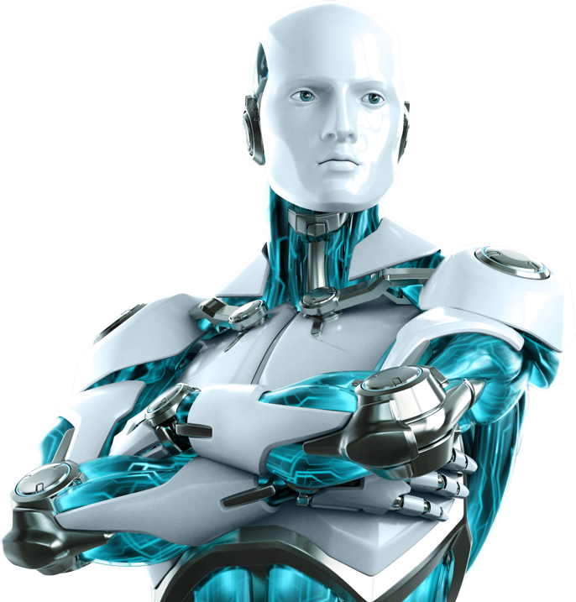
Role of Engineers in the world
We Build the world: CIVIL Engineer
We Magic the world: Computer Engineer
We Connect the world: Electrical Engineer
We Move the world: Mechanical Engineer
We are the Magician of world
Computer Engineer

Slide 4



Life without Engineer
No power, No Production, No communication, and Development is impossible
EAST OR WEST
In simple words:
Life is impossible without engineer
Engineers
Are the West

Slide 5






Li-Fi is a wireless Optical networking technology that uses light Emitting Diodes that is LEDs for data transmission
Wi-Fi is a wireless technology which uses Radio Signals for data transmission

Slide 6

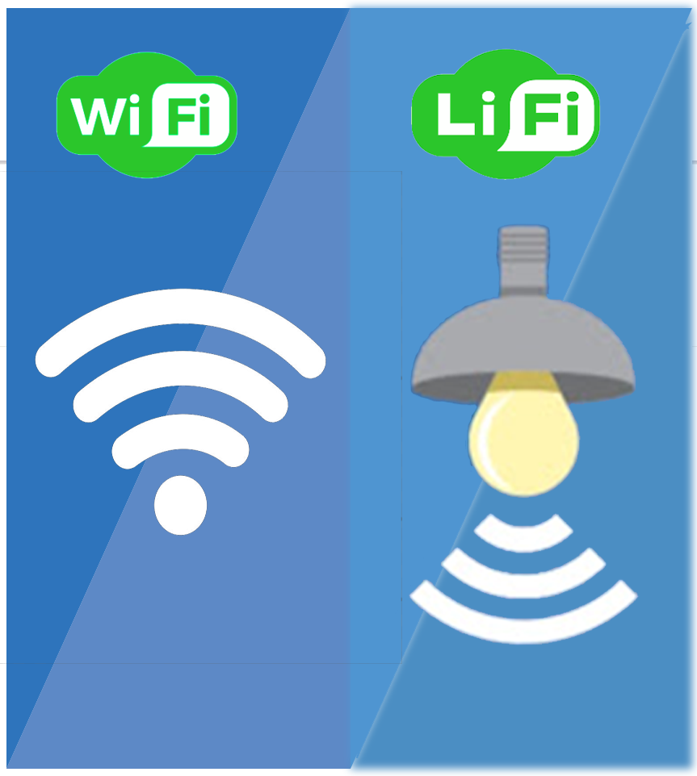


LiFi uses light as medium for data communication where as WiFi uses Electromagnetic waves fordata communication.
LiFi is optical communication technology where as WiFi is radio communication technology.
Li-Fi signals cannot pass through walls, so in order to enjoy full connectivity, capable LED bulbs will need to be placed throughout the home.
using Li-Fi instead of Wi-Fi, you'll negate lots of security problems associated with shared and often overloaded broadband networks

Slide 7

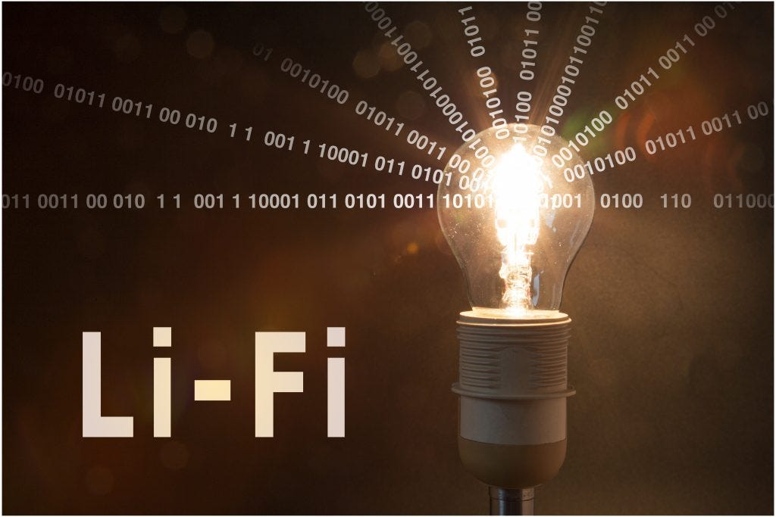
LI-FI Benifits
Higher speeds than wifi 10,000 Times the frequency spectrum of radio.
More secure because data cannot be Intercepted without a clear line of sight.

Slide 8

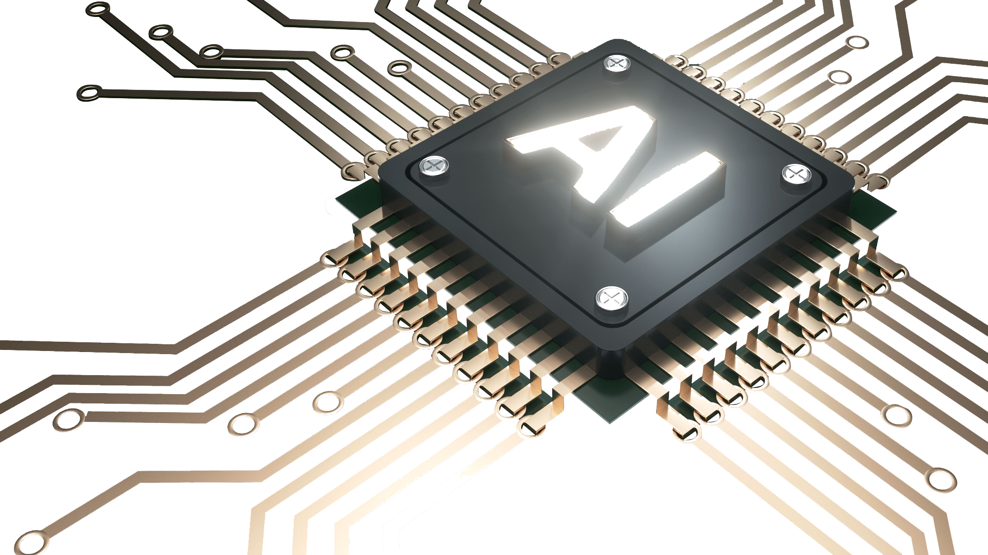

Designed By Suraj Arya
Thanks for watching
Have a Great day
Engineers are the Magician of science
Computer Science Engineering

